Slide 1
Frontend Introduction

Slide 2
What is SPA ?
A web application that fits on a single web page with the goal of providing a more fluid user experience akin to a desktop application
List SPA websites examples
https://onepagelove.com/gallery/application/page/2

Slide 3
Multi Page Drawback :
web applications have suffered from poor interactivity and responsiveness towards end users

Slide 4
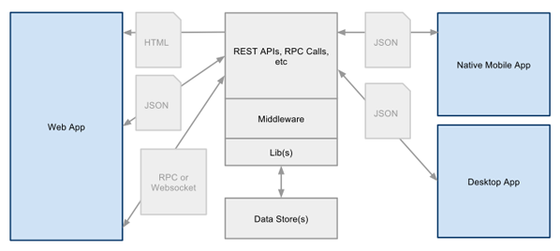
SPA Architecture
Client
Server
Client

Slide 5
SPA Technique
Asynchronize Request
AJAX
Get Server Resources
REST API
Data Transfer Format
JSON
A MVC Client Web Framework
Angular JS, Knockout.js ...
Notes:
Others SPA technique : Web-socket API , History API

Slide 6
What is AJAX?
Asynchronous JavaScript and XML
Exchanging data with a server, and updating parts of a web page without reloading the whole page
Demo
http://www.w3schools.com/jquery/jquery_ajax_intro.asp (JQuery based)
http://www.w3schools.com/ajax/default.asp

Slide 7
What is REST API?
Representational State Transfer
A simpler alternative to SOAP and WSDL based Web services
Video
https://www.youtube.com/watch?v=7YcW25PHnAA
Notes:
https://ihower.tw/blog/archives/1542

Slide 8
What is JSON?
JavaScript Object Notation
An open standard format that uses human-readable text to transmit data objects consisting of key–value pairs
Video
http://www.lynda.com/JavaScript-tutorials/What-JSON/114901/125761-4.html

Slide 9
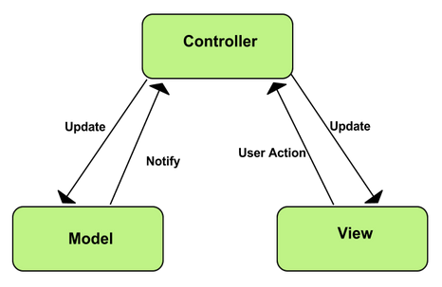
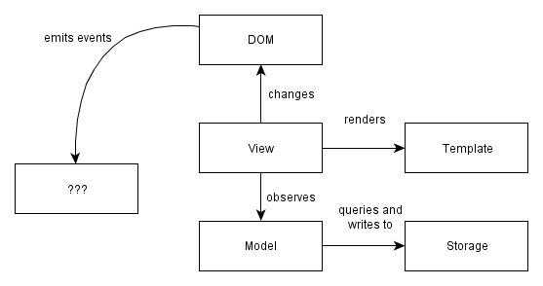
MVC Java-script Framework

